Slide 1
User Authentication Using Classical Machine Learning: Leveraging Key Typing Dynamics Behavior
ITI105 Project Presentation
23-August-2023
ALLEN LEE and Jacob Abraham

Slide 2

Contents
Jacob
Problem statement and Solution
ML formulation
Data preparation, Exploratory Data Analysis, and Feature Engineering
Modelling and Experiments
Allen
Final model selection
Error Analysis
Deployment and Inference – Application
Conclusion

Slide 3
Problem statement and Solution
Problem
Computing devices, including mobile phones, use various biometric authentication methods like fingerprints or facial features to identify users.
However, these methods rely on specific hardware, which can increase the overall cost.
Solution
An economical alternative is to authenticate users based on their behaviour, such as typing dynamics.
Keystroke dynamics (keystroke biometrics) pertain to the comprehensive timing data that precisely records the moment each key is pressed and released as an individual types a password on a computer keyboard.
Through capturing the intervals between key presses, key hold durations, and the periods between key releases and next key presses, significant user insights can be derived.
When the user logs in again, companies can compare their present typing pattern with their past patterns, allowing for authentication to distinguish legitimate users from potential fraudulent ones.

Slide 4
ML Formulation:
ML Problem statement
We want to create a machine learning model that accurately identifies users based on their typing dynamics, achieving a high level of authentication performance and provide a cost-effective alternative to biometric authentication methods for computing devices.
Ideal outcome
The ideal outcome would be a reliable and cost-effective user authentication system that eliminates the need for specialized hardware, making it accessible and affordable for a wide range of computing devices.
Success metrics
High authentication accuracy, Cost-effectiveness, consistent and stable performance over time, Robustness against impersonation, and positive user acceptance.
Failure metrics
False accept rate, False reject rate, Inconsistency in user authentication, Vulnerability to impersonation, and low user acceptance and satisfaction levels.

Slide 5
ML Formulation:
Input to the model:
Keystroke timings obtained from 11 users, typing the password ‘.tie5Roanl’.
ML model:
Our problem is best framed as a Supervised Multi-class Classification task, which predicts whether the user’s typing dynamics match the authorized user profile or not.
Output of the ML model:
The output of the machine learning model would be a multi-class decision indicating whether the user's typing dynamics match the authorized user profile or not.
Hypotheses, and assumptions:
Typing dynamics are sufficiently distinct and consistent among individuals
There are enough data samples available to train and evaluate the machine learning model effectively.
Individuals have unique typing patterns that can be captured and used for user authentication, and that these patterns remain consistent over time.

Slide 6
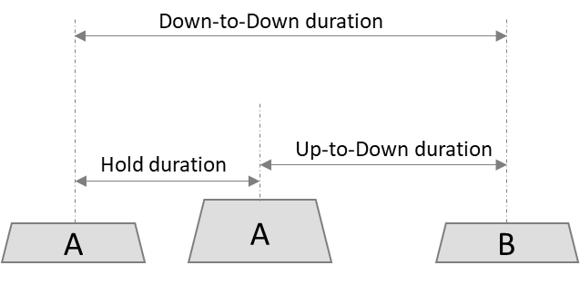
Data preparation, Exploratory Data Analysis and Feature Engineering
Dataset
Critical information that is captured during typing a password are:
Hold duration (H):
Time from when a key was pressed to when it was released.
Up-to-Down (UD) duration:
Time from when key1 was released to when key2 was pressed.
Down-to-Down (DD) duration:
Time from when key1 was pressed to when key2 was pressed.
Benchmark dataset was downloaded from Carnegie Melon University http://www.cs.cmu.edu/~keystroke/.
Data consist of keystroke-timing information from 51 subjects (typists), each typing same 10-character password “.tie5Roanl” 400 times (in 8 sessions, with 50 repetitions per session).
One additional user data (414 keystroke timing samples from Allen) was collected.
Final dataset: Created a hybrid dataset by merging the first 10 users’ samples and Allen’s 414 keystroke samples.

Slide 7
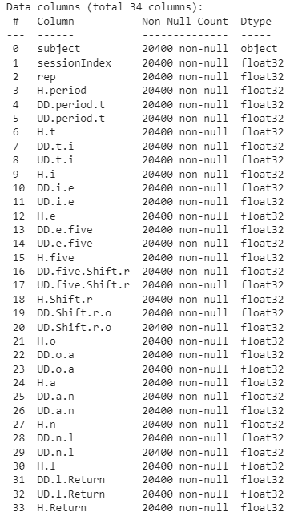
Data preparation, Exploratory Data Analysis and Feature Engineering
Dataset
Total number of samples in CMU dataset is 20400.
Total number of samples in hybrid dataset is 4414.
Features (and their data types):
Note:
H.period: during the period “.” Key was held.
DD.period.t: Time from when period “.” was pressed to when “t” key was pressed.
UD.period.t: Time from when period “.” was released to when “t” key was pressed.

Slide 8
Data preparation, Exploratory Data Analysis and Feature Engineering
Data Analysis
Target is column “subject”, and its data type is “object”. Data type of all other columns are “float”.
Columns “sessionIndex” and “rep” are not used as it will not affect model training and testing.
There are no missing values and “NaN”s.
Columns of “Hold” duration shows low standard deviation compared to their corresponding “Up-to-Down” column.

Slide 9
Data preparation, Exploratory Data Analysis and Feature Engineering
Data Analysis
Values in all columns of “Down-to-Down” are the sum of their corresponding values in columns of “Hold” and “Up-to-Down”. Columns of “Up-to-Down” shows strong correlation with column “Down-to-Down”. Calculated correlation coefficients for these pairs of ‘Down-to-Down' and ‘Up-to-Down' for each character keypress are above 0.9 as shown below.
Hence all columns prefixed with “DD”, are to be dropped to reduce the effects on model training due to correlated features. This reduces the number of features from 31 to 21.

Slide 10
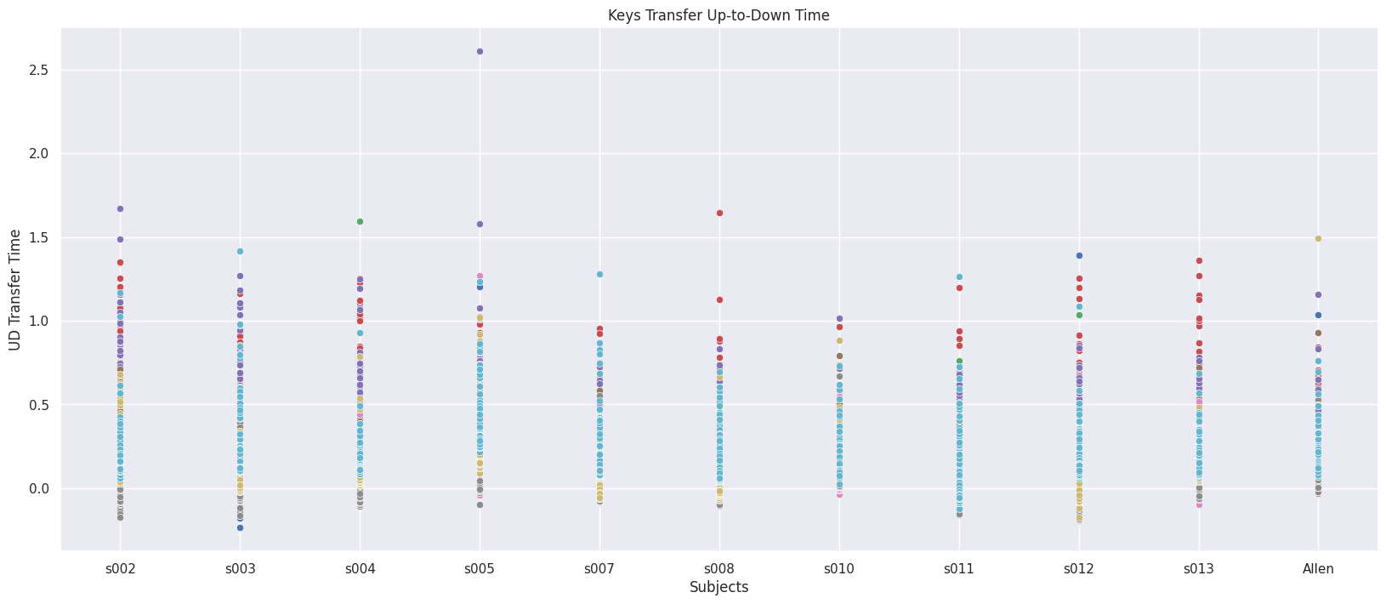
Data preparation, Exploratory Data Analysis and Feature Engineering
Data Analysis
It is also noted that “Up-to-Down” values can be negative. The range of “UD.period.t” is from -0.24 to 12.45.

Slide 11
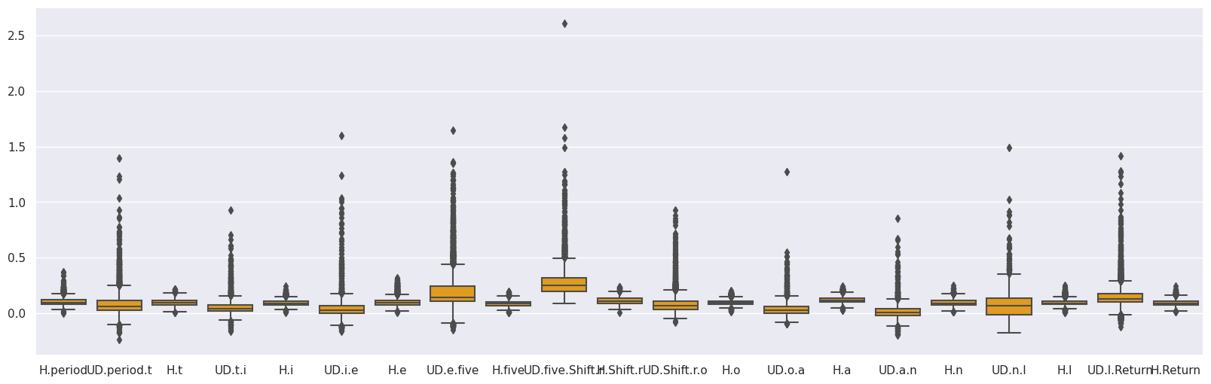
Data preparation, Exploratory Data Analysis and Feature Engineering
Data Analysis
Outliers were also observed with analysis and visualization.
Performance of Random Forest Classier with and without outliers was found to be the same.
All numerical features of the dataset were scaled to ensure that the features have comparable magnitudes.

Slide 12
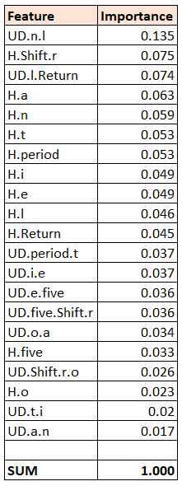
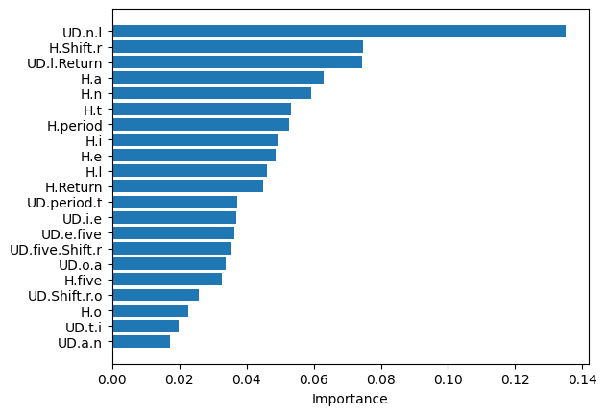
Data preparation, Exploratory Data Analysis and Feature Engineering
Data Analysis
Feature importance analysis was performed using Random Forest Classifier.
21 features (from the original 31 features) were selected for final feature set.

Slide 13
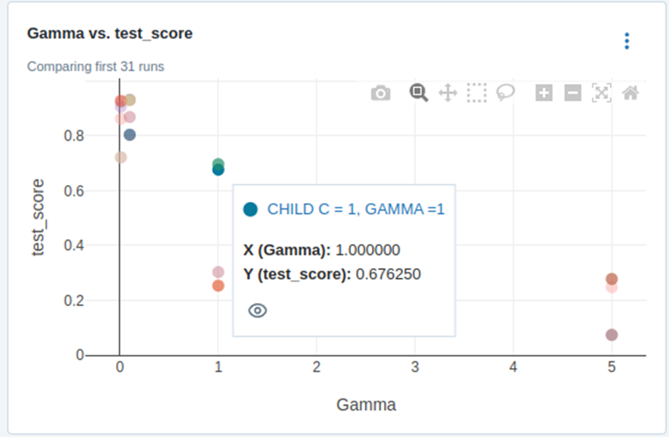
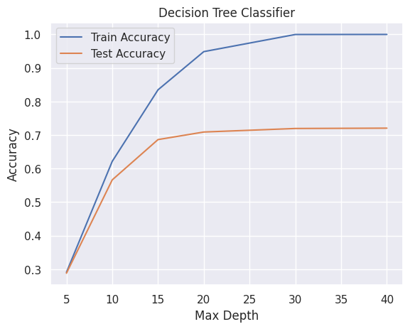
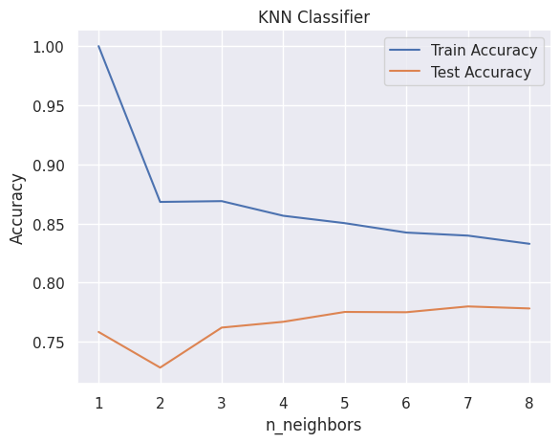
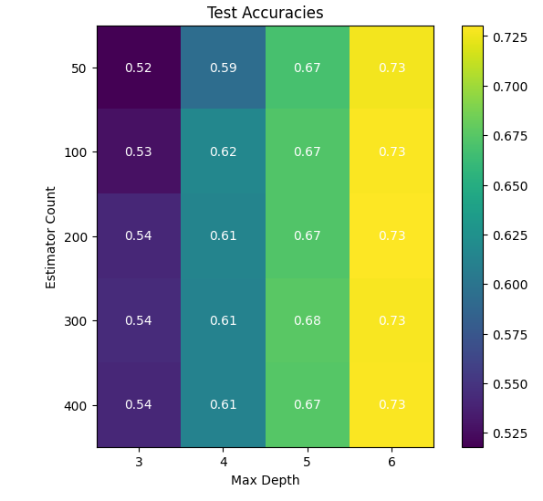
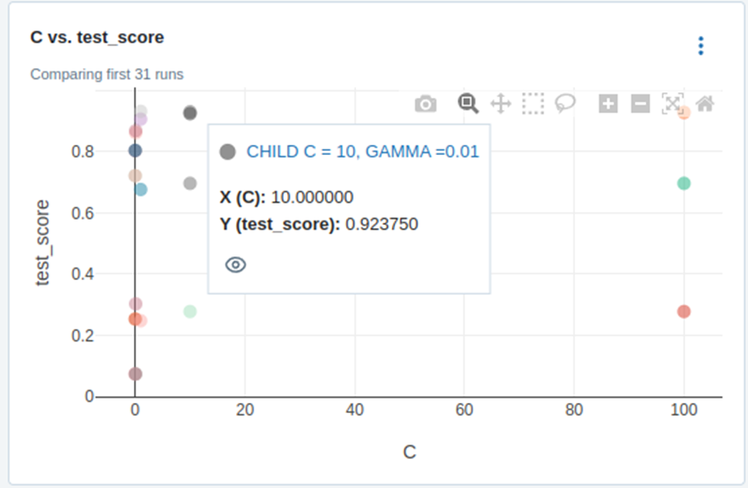
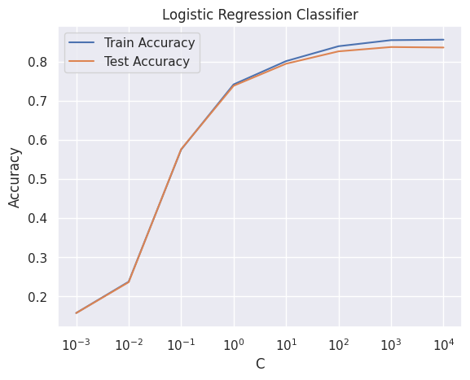
Modelling and Experiments
Modelling with benchmark dataset
Base Learning
Decision Tree
K-Nearest Neighbors
Naive Bayes
Logistic Regression
Support Vector Machine
Ensemble Learning
Random Forest
AdaBoost
Gradient Boosting
Voting Classifier
Stacking Classifier
Random Forest

Slide 14
Modelling and Experiments
Modelling with benchmark dataset

Slide 15
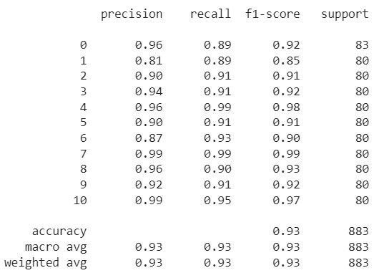
Modelling and Experiments
Modelling with hybrid dataset
SVM with ‘RBF’ kernel
Best parameters: {'svm__C': 10, 'svm__gamma': 0.01}
Best cross validation accuracy: 0.94
Test set score: 0.93
Subject-s002 has the worst metrics among 11 subjects
Subject-s010 has the best metrics among 11 subjects

Slide 16
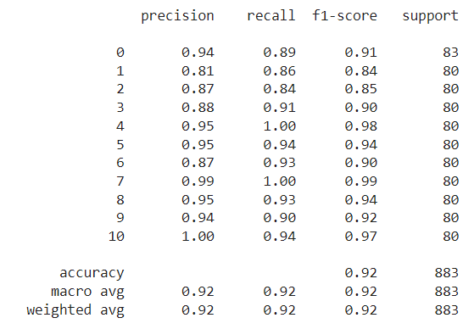
Modelling and Experiments
Modelling with hybrid dataset
SVM with ‘Poly’ kernel
Best parameters: {'svm__C': 10, 'svm__degree': 3} Best cross validation accuracy: 0.93
Test set score: 0.93
Subject-s002 has the worst metrics among 11 subjects
Subject-s010 has the best metrics among 11 subjects

Slide 17
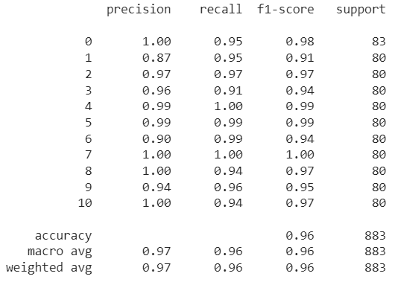
Modelling and Experiments
Modelling with hybrid dataset
Gradient Boosting Ensemble Learning
Best parameters: {learning_rate=0.1, n_estimators=300, subsample=0.9}
Best cross validation accuracy: 0.97
Test set score: 0.97
Subject-s002 has the worst metrics among 11 subjects
Subject-s010 has the best metrics among 11 subjects
Notes:
Subsamples:
The fraction of samples to be used for fitting the individual base learners. Values must be in the range (0.0, 1.0].
If smaller than 1.0 this results in Stochastic Gradient Boosting.
Subsample interacts with the parameter n_estimators.
Choosing subsample < 1.0 leads to a reduction of variance and an increase in bias.

Slide 18



Final Model Selection and Error Analysis
Model Finalization
Model | Hyper-parameters | Precision (macro avg) | Recall (macro avg) | F1-score (macro avg)
SVM with ‘RBF’ kernel | C= 10 γ=0.01 | 0.93 | 0.93 | 0.93
SVM with ‘Poly’ kernel | C= 10 degree=3 | 0.92 | 0.92 | 0.92
Gradient Boosting | learning_rate=0.1 n_estimators=300 subsample=0.9 | 0.97 | 0.96 | 0.96
Predictions were consistent among the 3 Models with respect to subjects’ prediction metrics.
Gradient boosting gives the best metrics among the three models and hence selected as final model.
Notes:
Subsamples?

Slide 19
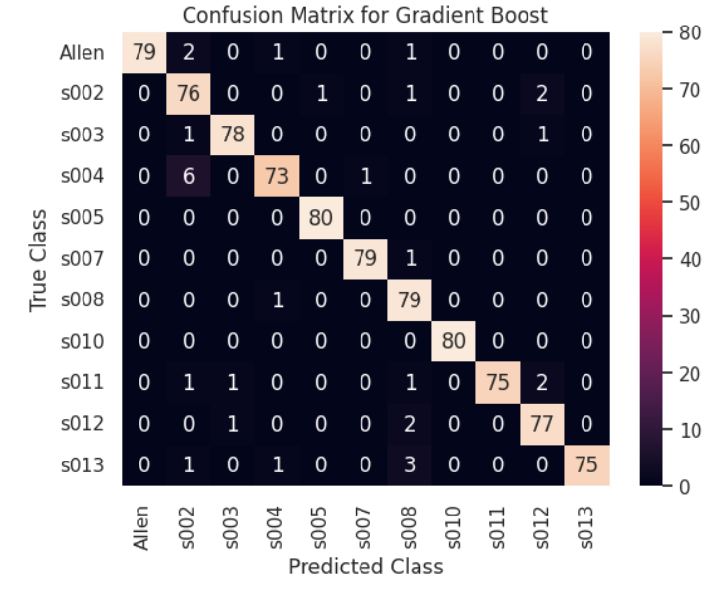
Final Model Selection and Error Analysis
Error Analysis
Subject ‘s004’ that has relatively higher number (7) of mis-classifications.
Six samples of ‘s004' are incorrectly predicted as ‘s002' by the final trained model.
Key hold duration for 'H.Shift.r' (Shift-R key press) is longer for those correctly classified samples than those which are incorrectly classified by the model.
Notes:
Subsamples?

Slide 20
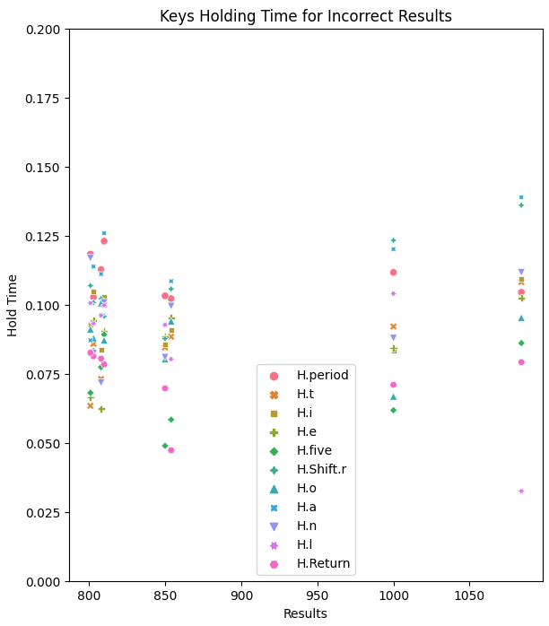
Final Model Selection and Error Analysis
Error Analysis
Incorrectly classified samples tends to cluster around 4 sampling sessions as can be seen in the visualization.
This might be due to some abnormal keypress from the subject during those sessions or day when data was captured.
Notes:
Subsamples?

Slide 21
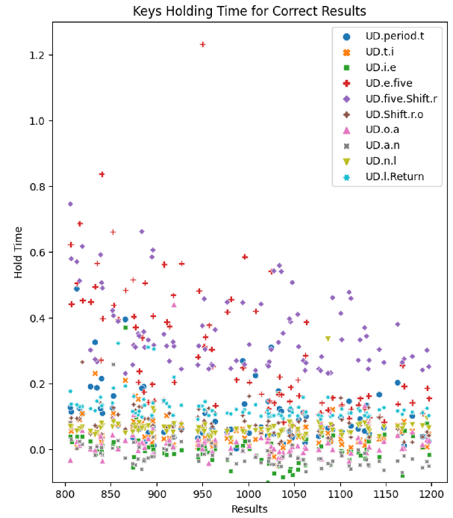
Final Model Selection and Error Analysis
Error Analysis
There are many samples with negative key travel timing in the correctly classified samples for this subject.
This suggests that the subject has pressed the next key before releasing the previous key in sequence.
Notes:
Subsamples?

Slide 22








Deployment / Application - Architecture
Trained Model
REST API Server
Web Server
Client

Slide 23
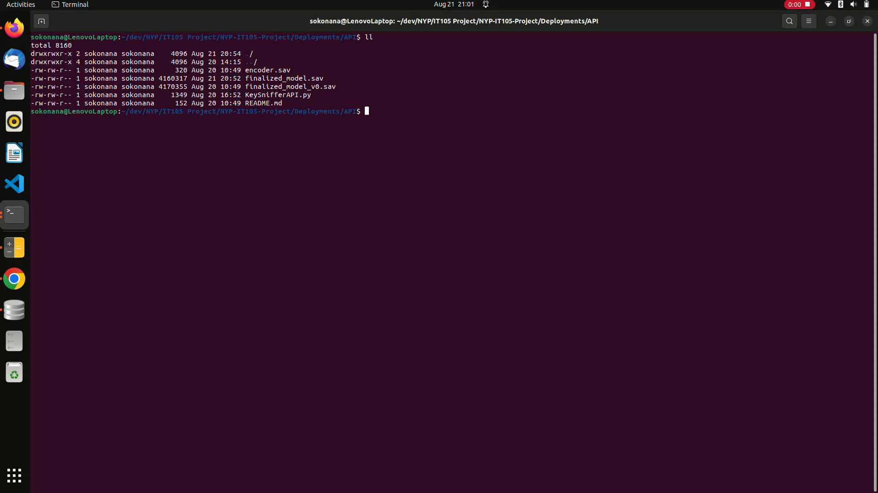
Deployment / Application - Screen Recordings

Slide 24
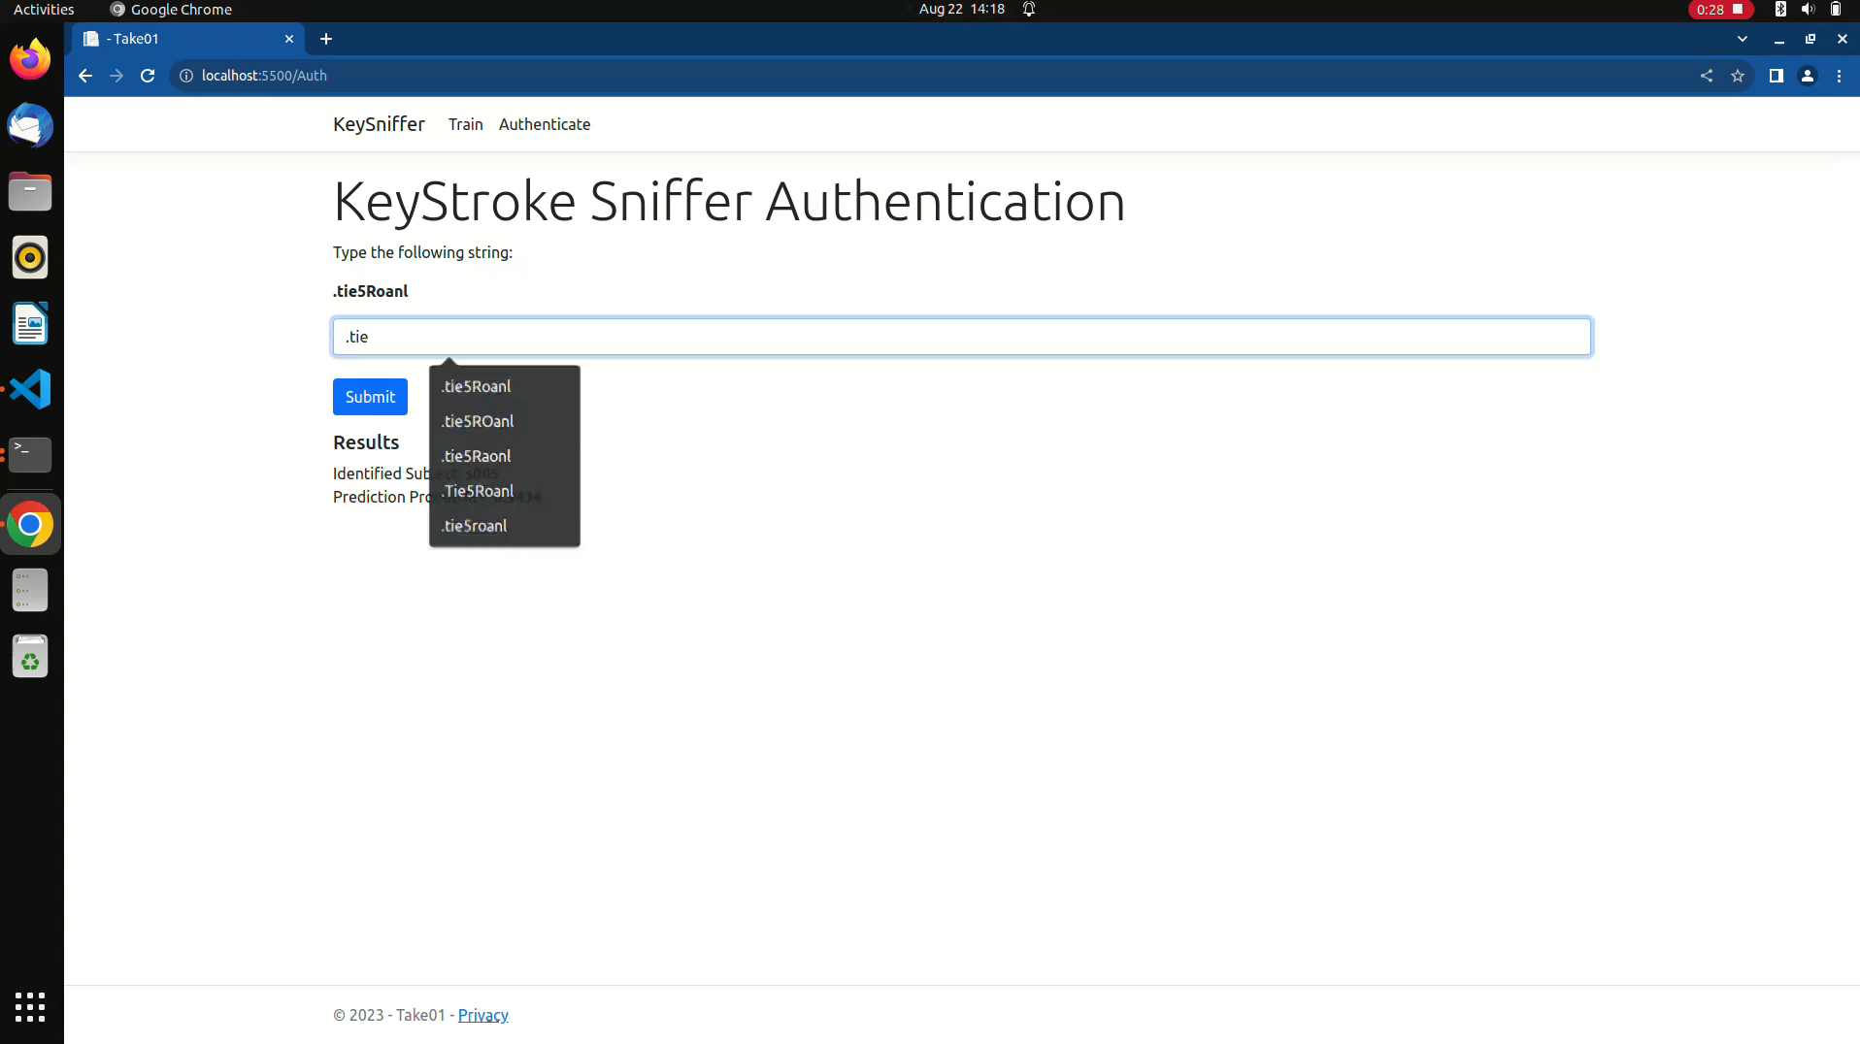
Deployment /Application - Screen Recording for Unidentified Subject
Any prediction with probability less than 0.8 will be interpreted as 'Unidentified Subject'

Slide 25
Conclusion
Performance summary:
Gradient Boosting model with high performance metrics (Precision and Recall) has proved the hypothesis that keystroke dynamics can be applied for user authentication.
As the original users are not available for actual inference, user satisfaction, acceptance rate and other success / failure metrics could not be measured
Next steps
Hardware and time constraints in modelling has limited the hybrid dataset sample size to 4414.
With better hardware, all (20400) the original benchmark dataset samples can be used to model with reasonable amount of time.
Lessons learnt
ML Formulation
Data Analysis, Feature selection, Cross validation, base estimators and ensemble learning.
‘MLFlow’ and application deployment.

Slide 26
Contribution
Jacob:
Sourced initial c code for “Key-Sniffer’.
Data visualization and Model Evaluation with Decision Tree, K-Nearest Neighbours, Support Vector Machine, Gaussian Naive Bayes, Logistic Regression, Random Forest and Gradient Boosting.
Platform: Google CoLab
Allen:
Upgrading and fine tuning of “Key-Sniffer” program to collect keystroke data.
Data visualization and Model Evaluation with Decision Tree, K-Nearest Neighbours, Naive Bayes, Logistic Regression, Support Vector Machine, Random Forest, Gradient Boosting, and Voting Classifier
Experiment logging.
Error Analysis.
Model deployment and inference.
Platform: Jupyter Notebook

